Slide 1
The Way of Man
Osamagbe Lesley EGHAREVBA
Presented At The Church of Christ, Owode Elede, Mile 12, Lagos
On Friday, 25th November, 2022 (Gospel Lectureship)

Slide 2
Texts
Proverbs 14:12; 16:25
There is a way that seems right to a man, But its end is the way of death.
Jeremiah 10:23
O Lord, I know the way of man is not in himself; It is not in man who walks to direct his own steps.
Proverbs 16:2
All the ways of a man are pure in his own eyes, But the Lord weighs the spirits.

Slide 3
Introduction
The way of man, as the Bible says, is not in himself. When man is left to his own devices, he travels paths that are dangerous and deadly.

Slide 5
Introduction
Man may believe himself to hold the knowledge to plan and direct his own path, but it is not in him to do so. The way that seems right to a man ends in death. We have to trust in God to direct our steps.

Slide 7
Man’s Ways Versus God’s Way In Bible Times

Slide 8
Naaman (II Kings 5:9-14)
He was sick with leprosy
The man of God (Elisha) asked him to dip himself in the Jordan river 7 times
Naaman thought of some “better” ways he would have been healed (verses 11-12)

Slide 9
Naaman (II Kings 5:9-14)
There was ONLY one way for Namman to be saved (cleansed of his leprosy)
He became cleansed ONLY after he followed the ONLY way.

Slide 10
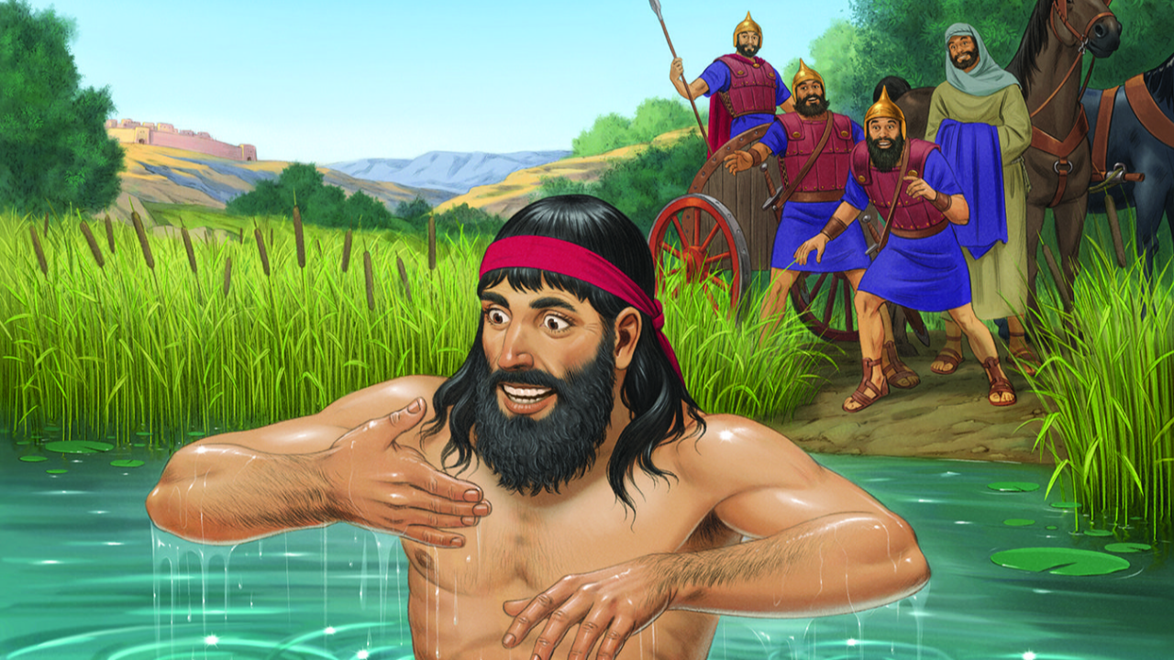
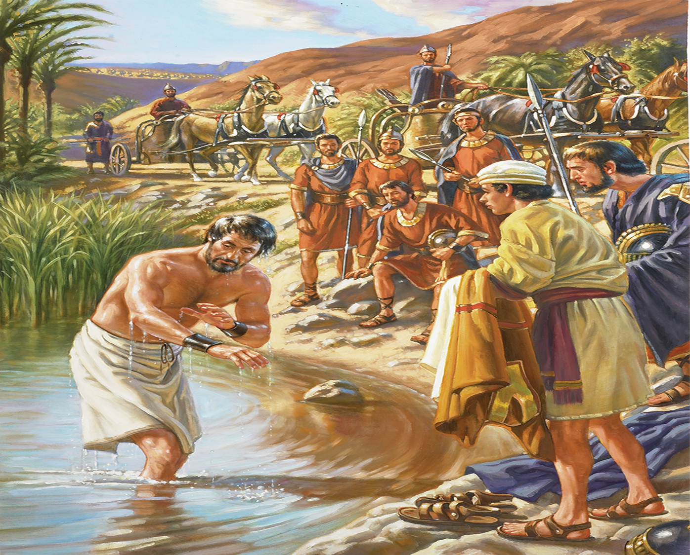
Naaman (II Kings 5:9-14)

Slide 11
The Pharisees (Matthew 15:1-9)
They despised the commandment of God because of their own tradition
God's way is for people to honour their father and mother but the pharisees teach otherwise (vs. 4-6)
The result was vain worship since they teach for doctrines the commandments of men
There was only one way for the pharisees to be pleasing to God – by following His commandments.

Slide 12
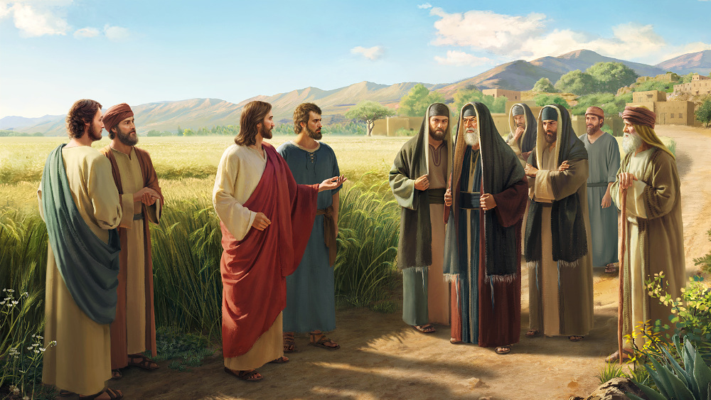
The Pharisees (Matthew 15:1-9)

Slide 13
Adam and Eve (Genesis 3:1-7)
They were expected not to eat of the fruit of the tree in the midst of the garden
The Serpent came and change God's instruction
They ate from it and were separated from God (vs 24)
There was only one way to remain in the garden of Eden – to remain obedient to God.

Slide 14
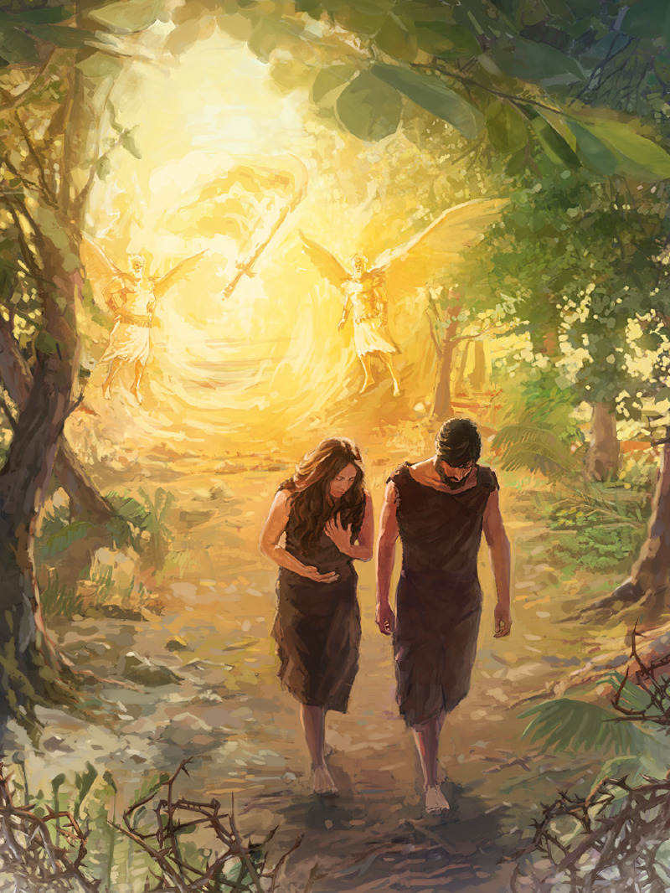
Adam and Eve (Genesis 3:1-7)

Slide 15
Man’s Ways Versus God’s Way Today

Slide 16
Man’s Ways Versus God’s Way Today
Many religious people today have circumvented God's way for their own ways when it comes to the matter of salvation. But there's only one way to heaven (John 14:6). Christ became the author of eternal salvation to all who obey Him (Hebrews 5:9).
Let us look at some of the ways of man that gives no salvation:

Slide 17
Sinner’s Prayer
Many today believe that sinner’s prayer would save a man. But the terms and concept are not found in the Bible.
Mark 16:16 teaches that Belief + Baptism is what would save a man.
We never read of anyone in the New Testament that was saved by the “sinner’s prayer”

Slide 19
Faith Alone/Faith Only
Many teach that believing in Christ alone is what saves a man. But Acts 2:38, Mark 16:16, and Acts 22:16 all teach the exact opposite.
The words “faith only” occur only once in the Bible; and in that occurrence, it is said that we are not saved by it (James 2:24)
Faith without works is dead (James 2:14,17,20,26)

Slide 20
Faith Alone/Faith Only
Galatians 3:26-27 teaches that the kind of faith that saves a man is the kind of faith that includes baptism. “We are all children of God by faith in Christ Jesus. For as many of you as have been baptized into Christ have put on Christ.”

Slide 21
Faith Alone/Faith Only
Paul said in Galatians 5:6; “For in Christ Jesus neither circumcision nor uncircumcision avails anything, but faith working through love.”
The faith that avails is the one that brings the blessings of God, and notice how that is done:
I John 5:3 - “This is the love of God, that we keep His commandments” That is the love of God, and faith working through love avails; faith working through love saves; faith keeping the commandments of God is the salvation that has been promised.

Slide 22
Denominationalism
Many teach that one church is as good as the other. But the Bible teaches that there is only one body (Ephesians 4:4) and this body is the church (Ephesians 1:22-23).
The saved are added to this one church (Acts 2:47).
The church of Christ today is just like the ark of Noah in the Old Testament. Only one ark could save them and only one church could save today. Denominationalism is actually sinful (I Corinthians 1:10-13; Romans 16:17).

Slide 23
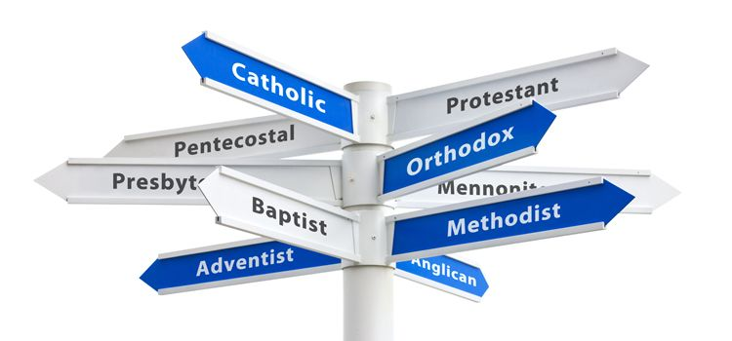

Slide 24
Idolatry
Many find solace in idolatry but there's no salvation in it.
The children of Israel made a golden calf as a god to lead them but it did nothing for them (Exodus 32:1-35)

Slide 25
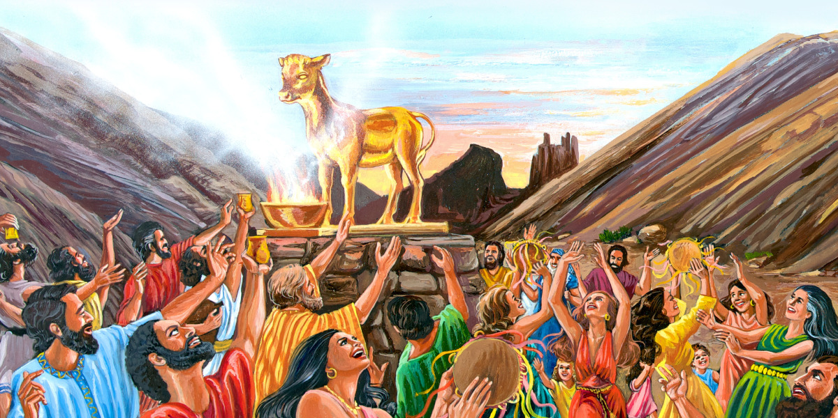

Slide 26
Idolatry
Rachael stole her father's gods perhaps for it to save or protect her but it was of no use (Genesis 31:19).
The Bible teaches idol is nothing in the world and there is no other God but one (I Corinthians 8:4)
We are to keep ourselves from idols (I John 5:21)

Slide 27
Cultism
Many belong to several cults because they think they can get protection or salvation from them. But none of these offers salvation.
Salvation is only in the name of Jesus (Acts 4:12).

Slide 28
What Is God’s Way For Man To Be Saved Today?

Slide 29
There Is Only ONE WAY
God wants everyone to repent (II Peter 3:9; Acts 17:30-31)
What should we do in order to be saved?
Hear the word of God (Romans 10:17). It is the seed planted to produce faith.

Slide 31
There Is Only ONE WAY
Believe in the Word (Hebrews 11:6; Mark 16:16)
Repent of your sins (Acts 2:38; Luke 13:3)
Confess your faith in Christ (Acts 8:37)
Be baptized in water for the forgiveness of sins (I Peter 3:21).

Slide 34
Conclusion
Hebrews 5:9: And having been perfected, He became the author of eternal salvation to all who obey Him,
Christ has become the author of salvation to those who obey Him. It is only by obedience that we can be purified in our souls:
1 Peter 1:22: Since you have purified your souls in obeying the truth through the Spirit in sincere love of the brethren, love one another fervently with a pure heart,

